Slide 1
ImPass
Graphical Password
Jordan Ballou, Anup Jacob, Jeffrey Robinson, Viraj Singh

Slide 2
Purpose of system
Purpose is having different authentication which isn't test based for a more secure authentication.The user would select four images in order from a pool of images. The image position will be randomized on login and the user will be required to select their images to log in to the site.
Accessibility - potentially easier to remember password, visual interface and simple input
Security - good against dictionary attack and brute force methods, can easily add more images to the database to increase possible combinations, add an image to password length to multiply possible passwords by n+1, n being current number of images (up to a certain level, too many images ruins the visibility)

Slide 3
Technical platform
Web app
Front-end
React
Back-end
Database
Google Firebase
Store all images
Store usernames/passwords
Each image associated with a number
In the back-end each graphical password can be seen as an array of numbers
Password checked by checking if selected array and stored array are equal

Slide 4
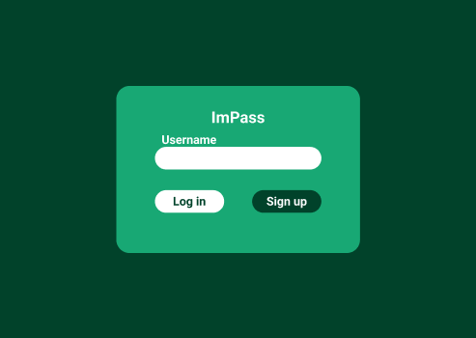
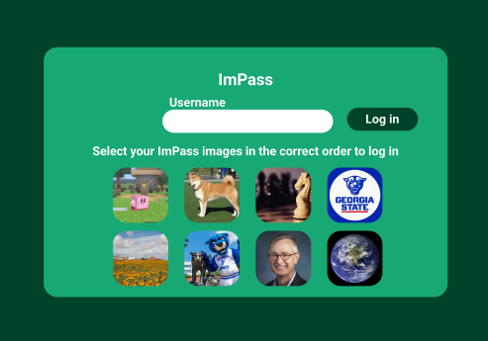
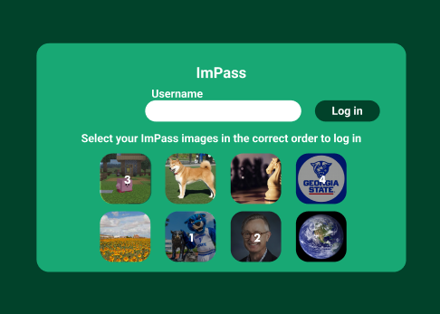
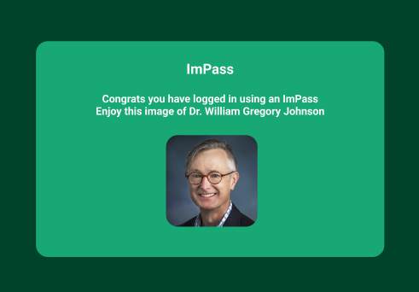
Login in Storyboard
Joe is prompted with the login screen
Joe enters his username
Joe selects his password in order from the shown images
Joe is sent to the logged in page

Slide 5
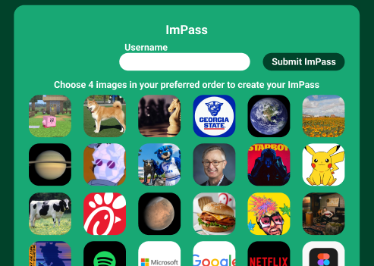
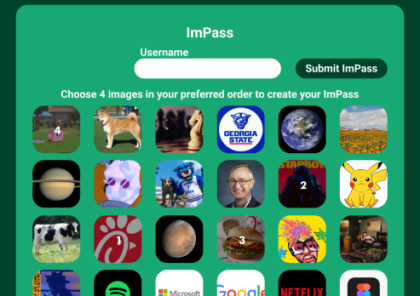
Register
Joe chooses a password combination
Joe enters a username
Joe is prompted with the login screen
Joe is sent to the logged in page
Joe selects his password in order from the shown images
Joe enters his username

Slide 6
Storyboards
Joe is prompted with the login screen | Joe clicks the register button | Joe chooses a username and clicks the images he wants to use as a password
Joe is asked to confirm the password order | Joe is asked for a recovery word | Joe is taken to the login screen
Joe is prompted with the login screen | Joe enters his username | Joe selects his password in order from the shown images
Joe is sent to the logged in page
Joe is prompted with the login screen | Joe enters his username | Joe forgot his password and clicks forgot password
Joe enters his recovery word | Joe selects his new password | Joe is taken to the login screen

